Slide 1
ERHS 630
Effective and Committed Effective Dose
Alexander Brandl
Environmental and Radiological Health Sciences

Slide 2
Effective Dose
Protection quantity as defined by ICRP
Additive if
  LNT assumption for stochastic effects
  in the low dose range (< 100 mSv)
Allows combination of different exposures
  external exposure
  internal exposure
  different types of radiation
Primary exposure limits in terms of a single quantity
  facilitates system of dose limitation
  record-keeping

Slide 3
Effective Dose (II)
w_{T} sex- and age-averaged
  E calculated for Reference Person
  not an individual
ICRP has specified 2 sex-specific computational phantoms for assessment of E
  Reference Female, Reference Male
Used for calculation of
  dose conversion coefficients for external,
  dose coefficients for internal exposure

Slide 4

Effective Dose (IV)
Computational phantoms
  used to calculate organ doses
  separately for females and males
  averaged equivalent doses to organ or tissues

Slide 5
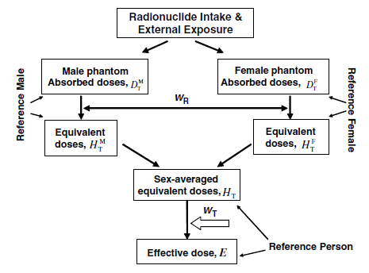
Effective Dose (V)
Sex-averaging (from ICRP 103)

Slide 6

Effective Dose (VI)
Effective dose
  in the whole body
  due to radiation R
$${E=\sum_{T}{w_{T}}H}_{T}=\sum_{T}{w_{T}}\sum_{R}{w_{R}D_{T,R}}$$
SI unit [J kg⁻¹] or [Sv]

Slide 7
Example
Laboratory accident:
  185 kBq ¹³¹I incorporated
  37 kBq deposited in thyroid
  148 kBq uniformly distributed in rest of body
  Internal dosimetry:
    H_{thyroid} = 61.5 mSv
    H_{rest body} = 0.13 mSv
E = ?

Slide 8

Example
E = ?
  H_{thyroid} = 61.5 mSv
  H_{rest body} = 0.13 mSv
$$E=\sum_{T}{w_{T}H_{T}}$$

Slide 9

Example
E = ?
  H_{thyroid} = 61.5 mSv
  H_{rest body} = 0.13 mSv
$$E=\sum_{T}{w_{T}H_{T}}$$
$$E=w_{thyroid}H_{thyroid}+w_{rest}H_{rest}$$

Slide 10

Example
E = ?
  H_{thyroid} = 61.5 mSv
  H_{rest body} = 0.13 mSv
$$E=\sum_{T}{w_{T}H_{T}}$$
$$E=w_{thyroid}H_{thyroid}+w_{rest}H_{rest}$$
$$E=\left(0.04×61.5\right)+\left(0.96×0.13\right)=2.6 \text{mSv}$$

Slide 11
Committed Effective Dose
Effective dose in case of internally deposited radioactive material
  radiation will deposit energy (dose) in organs or tissues over a certain period of time
  depending on
    physical half-life
    biological retention within the body
Resulting in an accumulation of dose over (possibly extended) periods of time
Definition of Committed Effective Dose

Slide 12
Comm. Effective Dose (II)
SI units like E
  [J kg⁻¹] or [Sv]
Additive to E
Total dose expected to be delivered to an organ / tissue or the whole body within a specified time period

Slide 13

Comm. Effective Dose (III)
Committed Equivalent Dose, H_{T}(τ)
Committed dose in an organ / tissue
Time period τ
$$H_{T}(τ)=\int_{t_{0}}^{t_{0}+τ}{\dot{H_{T}}\left(t\right)\text{d}t}$$
Committed Effective Dose
$$E\left(τ\right)=\sum_{T}{w_{T}H_{T}(τ)}$$

Slide 14

Comm. Effective Dose (IV)
Limiting parameters
  assume $τ→∞$
  radioactive material with very short half- life (let’s not talk about biological retention – yet)
  E(τ) = ?

Slide 15

Comm. Effective Dose (IV)
Limiting parameters
  assume $τ→∞$
  radioactive material with very short half- life (let’s not talk about biological retention – yet)
  E(τ) = ?
  $\dot{H_{T}}(t)→0$ very quickly

Slide 16

Comm. Effective Dose (IV)
Limiting parameters
  assume $τ→∞$
  radioactive material with very short half- life (let’s not talk about biological retention – yet)
  E(τ) = ?
  $\dot{H_{T}}(t)→0$ very quickly
  $H_{T}(τ)$ non-trivial only for short period of time (say for a few half-lives, T)

Slide 17
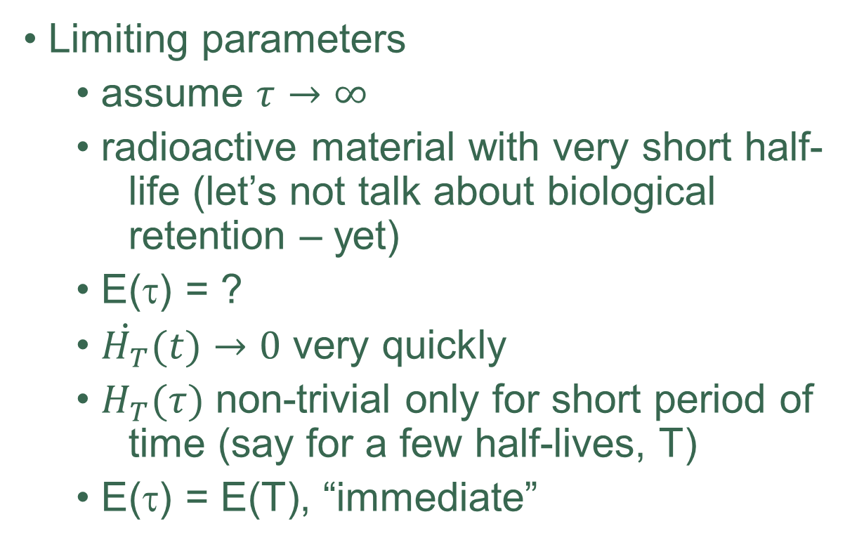
Comm. Effective Dose (IV)
Limiting parameters
  assume $τ→∞$
  radioactive material with very short half- life (let’s not talk about biological retention – yet)
  E(τ) = ?
  $\dot{H_{T}}(t)→0$ very quickly
  $H_{T}(τ)$ non-trivial only for short period of time (say for a few half-lives, T)
  E(τ) = E(T), “immediate”

Slide 18

Comm. Effective Dose (V)
Limiting parameters
  assume $τ=50$
  radioactive material with half-life >> 50 years (let’s not talk about biological retention – yet)
  E(τ) = ?

Slide 19

Comm. Effective Dose (V)
Limiting parameters
  assume $τ=50$
  radioactive material with half-life >> 50 years (let’s not talk about biological retention – yet)
  E(τ) = ?
  $\dot{H_{T}}\left(t\right)≅const.$ over 50 years

Slide 20

Comm. Effective Dose (V)
Limiting parameters
  assume $τ=50$
  radioactive material with half-life >> 50 years (let’s not talk about biological retention – yet)
  E(τ) = ?
  $\dot{H_{T}}\left(t\right)≅const.$ over 50 years
  $H_{T}\left(50\right)≅\dot{H_{T}}×50$

Slide 21

Comm. Effective Dose (V)
Limiting parameters
  assume $τ=50$
  radioactive material with half-life >> 50 years (let’s not talk about biological retention – yet)
  E(τ) = ?
  $\dot{H_{T}}\left(t\right)≅const.$ over 50 years
  $H_{T}\left(50\right)≅\dot{H_{T}}×50$
  E(50) constant annually, E(1) = E(50)/50

Slide 22
Comm. Effective Dose (VI)
ICRP recommendations (ICRP 103)
  for compliance with dose limits
  committed effective dose assigned to year in which intake occurred
  workers: τ = 50 years (working-life expectancy for young adult entering work force
  public: τ = 50 years for adults,
  τ = (70 – age) years for children

Slide 23

“Total” Effective Dose
Occupational and compliance monitoring
Dose limits assessed against “Total” Effective Dose
  Effective Dose, E
Contributions are additive!

Slide 24

“Total” Effective Dose (II)
E contributions:
  external exposure
  internal exposure
    inhalation
    ingestion
    (direct absorption / wound)
$$E=E_{ext}+E_{inh}\left(50\right)+E_{ing}(50)$$
SI unit [J kg⁻¹] or [Sv]

