Slide 1
ERHS 630
Radiation and Tissue Weighting Factors
Alexander Brandl
Environmental and Radiological Health Sciences

Slide 2
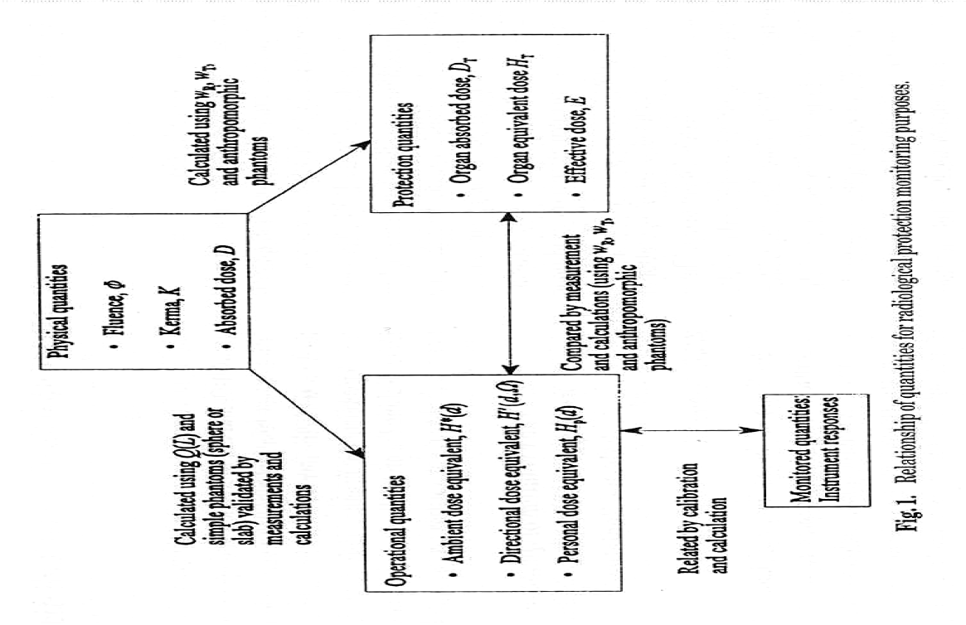
System of Quantities
Dosimetric quantities for external radiation (from ICRP 74 / ICRU 57)

Slide 3
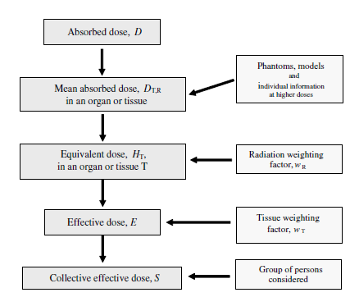
Absorbed to Effective Dose
Dose relations
(from ICRP 103)

Slide 4
Absorbed Dose
Defined for all types of ionizing radiation
Quotient of
mean energy imparted in a volume element
divided by the mass of matter in that volume element
Definition at a point in tissue / organ
used to define operational quantities
Average over tissue / organ
used to define protection quantities

Slide 5

Organ Absorbed Dose
Mean absorbed dose averaged over a specified tissue or organ, D_{T} (absorbed dose distribution in the body or phantom is known)
$$D_{T}=\frac{1}{m_{T}}\int_{m_{T}}^{ }{D \text{d}m}=\frac{1}{m_{T}}\int_{m_{T}}^{ }{\frac{\text{d}\overline{ε}}{\text{d}m}\text{d}m}$$
$$D_{T}=\frac{\int_{T}^{ }{D\left(x,y,z\right)ρ\left(x,y,z\right)\text{d}V}}{\int_{T}^{ }{ρ\left(x,y,z\right)\text{d}V}}$$
SI unit [J kg⁻¹] or [Gy]

Slide 6
Radiation Weighting
For both, operational and protection quantities
absorbed dose distributions are weighted
to account for biological effectiveness
Old definition:
charged particles depositing absorbed dose at the point of interaction in tissue
problem: radiation type depositing dose might be different than incident radiation
Current definition:
radiation incident on the body

Slide 7
Radiation Weighting (II)
Relative biological effectiveness, RBE
different types of ionizing radiation have varying effectiveness in producing radiation damage in a biological system
alpha-particles more effective than gamma radiation
neutrons more effective than gamma radiation
determining factor?

Slide 8

Radiation Weighting (III)
Relative biological effectiveness, RBE
determining factor?
LET
the higher the LET, the higher the potential for damage
RBE
ratio of amount of energy deposited by a reference radiation (generally low-LET) to produce a given biological effect
to the amount of energy by any other radiation to produce the same effect
$$RBE=\frac{D_{x}}{D}$$

Slide 9
Radiation Weighting (IV)
Relative biological effectiveness
can vary widely
RBE values are generally largest for small levels of effect
generally depends on
LET
dose rate
dose fractionation
type and magnitude of biological endpoint

Slide 10
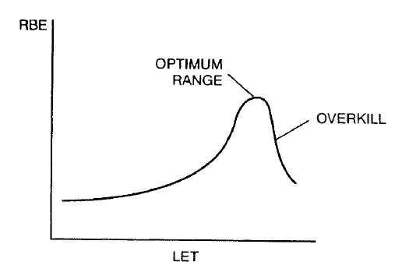
Radiation Weighting (V)
Cell killing: RBE as a function of LET (from Turner)

Slide 11
Radiation Weighting (VI)
Quality factor, Q
defined at the point of interaction
applied to D at point of interaction
still used by ICRU for operational quantities
Radiation weighting factor, w_{R}
determined by the radiation incident on the body
applied to D_{T} in the tissue / organ of interest
used by ICRP for protection quantities

Slide 12

Quality Factor
Radiation weighting for operational quantities only
Mean quality factor in matter, $\overline{Q}$
function of L
$$\overline{Q}=\frac{1}{D}\int_{L=0}^{∞}{Q(L)\frac{\text{d}D}{\text{d}L}\text{d}L}$$
$\overline{Q}$ averaged over a volume (tissue / organ)
$$\overline{Q}=\frac{1}{m_{T}D_{T}}\int_{m_{T}}^{ }{\int_{L}^{ }{Q(L)\frac{d\overline{ε}(L)}{dm}dL}dm}$$

Slide 13

Quality Factor (II)
Quality factor as a function of LET
particle LET in water
(from ICRP 103)

Slide 14

Dose Equivalent
Retained here mainly for historical reasons
Denoted as H
Product of Q and D at a point in tissue
$$H=QD$$
SI unit [J kg⁻¹] or [Sv]

Slide 15
Radiation Weighting Factor
Defined for protection quantities
D_{T} is multiplied by the radiation weighting factor, w_{R}, to account for relative radiation detriment due to different types of radiation
w_{R} concerned only with incident radiation
no need to account for secondary particles, etc.
Averaging already applied to D_{T}

Slide 16
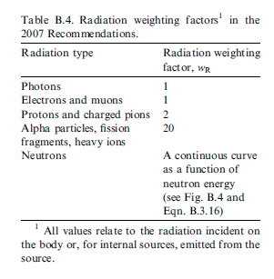

Rad. Weighting Factor (II)
w_{R} for various types of radiation
(missing ones may be approximated by $\overline{Q}$ - ICRP 60)
(from ICRP 103)

Slide 17
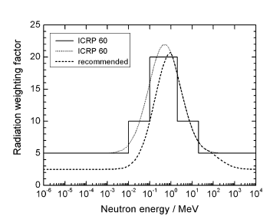

Rad. Weighting Factor (III)
w_{R} for neutrons
(from ICRP 103)

Slide 18

Equivalent Dose
Protection quantity according to ICRP
Denoted as H_{T} (H_{T,R})
Product of D_{T,R} in an organ or tissue and the relevant w_{R}
$$H_{T,R}=w_{R}D_{T,R}$$
$$H_{T}=\sum_{R}{w_{R}D_{T,R}}$$
SI unit [J kg⁻¹] or [Sv]

Slide 19
Tissue Weighting Factor
Relates equivalent dose (in an organ or tissue) to effective dose (whole body)
Based on
epidemiological studies of cancer induction
experimental genetic data after radiation exposure
risk of hereditary disease over first two generations
judgement
Represent mean values for humans, averaged over
both sexes
all ages

Slide 20
Tissue Weighting Factor (II)
Takes into account different relative radiosensitivities of organs and tissues
Are relative values, Σw_{T} = 1
uniform dose distribution over whole body:
E numerically equal to every H_{T}
Separate assessment of risk of radiation- induced stochastic effects in males and females
Calculation of sex-specific radiation detriment
Determination of sex-averaged w_{T} values

Slide 21
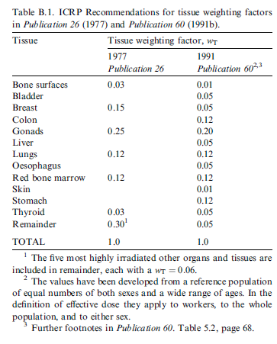
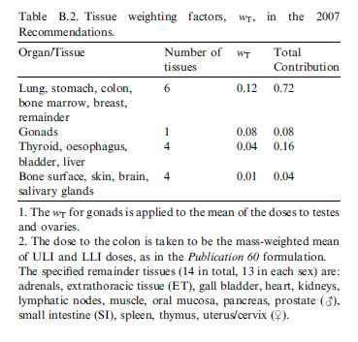
Tissue Weighting Factor (III)
Comparison “old” and current values
(from ICRP 103)

Slide 22
Tissue Weighting Factor (IV)
Main changes ICRP 60 to ICRP 103
breast 0.05 to 0.12
gonads 0.20 to 0.08
remainder tissue 0.05 to 0.12
additionally, 0.01 for brain, salivary glands
w_{T} appropriate for both sexes and all ages
special attention to thyroid, ovaries
thyroid: 0.04 allows for high susceptibility in children
ovaries: 0.08 gonads, ovaries 0.036 + 0.039 heritable

Slide 23

Tissue Weighting Factor (V)
How to treat “remainder tissue?”
Remainder: w_{T} = 0.12
No further mass weighting
since 13 tissues are specified for each sex, each tissue w_{T} < 0.01
Equivalent dose for remainder (sex-specific)

Slide 24

Effective Dose
Effective dose
in the whole body
due to radiation R
$${E=\sum_{T}{w_{T}}H}_{T}=\sum_{T}{w_{T}}\sum_{R}{w_{R}D_{T,R}}$$
SI unit [J kg⁻¹] or [Sv]

