Slide 1
ERHS 630
Exposure and Dose
Alexander Brandl
Environmental and Radiological Health Sciences

Slide 2
Radiation Dosimetry
Quantitatively relates
  measurements made in a radiation field
  to chemical / biological changes the radiation would produce in a target
Quantifies
  the incidence of various biological changes
  as a function of radiation received
  dose-effect relationship

Slide 3
Radiation / Target
Interaction between radiation and target atoms or molecules results in
  excitation
  ionization
  secondary electrons
Secondary electrons
  can be “ionizing”
  produce additional excitation and ionization

Slide 4
Radiation / Target (II)
Interaction occurs “locally” within the path of a charged particle
Chemical / biological effects
  electronic transitions producing chemically active species completed in very short time (≤ 10⁻¹⁵ s)
  due to direct absorption of energy from the radiation by the target
Interaction forms basis for
  radiation dosimetry
  radiation instrumentation

Slide 5
Energy Transfer
Ionization / excitation
Secondary particles
Delta rays
Threshold energy for ionization
(from ICRU 16)

Slide 6
Energy Transfer (II)
Energy deposited within volume element (mass) of interest (from ICRU 16)?

Slide 7
Energy Transfer (III)
Definition of “local?”
How to account for energy leaving the volume element (mass)?
Dependence on
  energy of incident radiation
  radiation type (“quality”)
Need to find radiation quantities, which allow quantification of
  physical observables
  biological effects

Slide 8
Radiation Fields
Generally
  non-uniform in space
  variable in time
Quantities
  often depend on discrete interactions between radiation and atoms
  would require:
    volume (mass) small enough that further reduction in size does not change the measured quantity
    large enough to contain many interactions and be traversed by many particles
Definitions of these quantities must include appropriate averaging procedures

Slide 9
Exposure
Physical quantity
Defined only for X-rays and gamma radiation
Energy transfer to air
  ionization (charge) produced in air
  charge per unit mass
  air at STP (standard temperature and pressure)

Slide 10
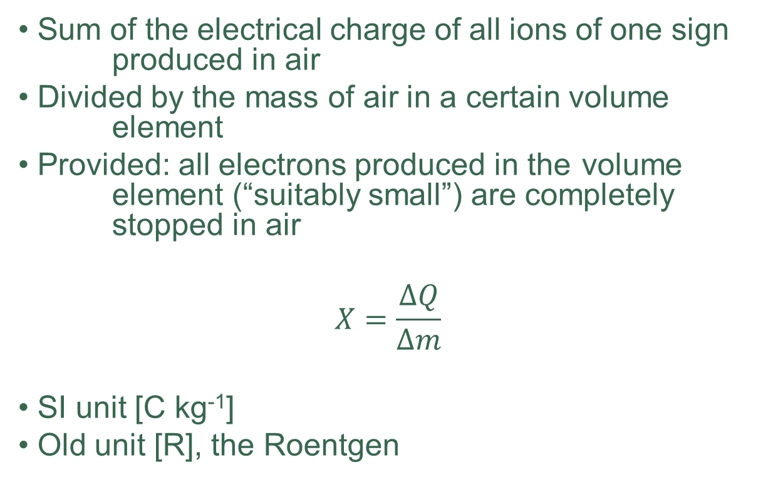
Exposure (II)
Sum of the electrical charge of all ions of one sign produced in air
Divided by the mass of air in a certain volume element
Provided: all electrons produced in the volume element (“suitably small”) are completely stopped in air
$$X=\frac{∆Q}{∆m}$$
SI unit [C kg⁻¹]
Old unit [R], the Roentgen

Slide 11

Exposure (III)
The Roentgen:
  charge of 1 esu in 1 cm³ of air
$$1 R=1\frac{esu}{{cm}^{3}}=$$
$$1\frac{esu}{{cm}^{3}}×\frac{3.336×{10}^{−10}C}{esu}×\frac{{10}^{3}{g kg}^{−1}}{{0.001293 g cm}^{−3}}=$$
$$={2.58×10}^{−4}\frac{C}{kg}$$

Slide 12
Absorbed Dose
Physical quantity
Defined for all types of ionizing radiation
Energy transfer to any target
  energy absorbed per unit mass in the material
  treated as a point function, having a value at any position in an irradiated object

Slide 13

Absorbed Dose (II)
Energy Imparted:
  radiant energy incident on matter (R_{in}), sum of all charged and uncharged particles entering a volume element
  minus radiant energy emerging from that volume element, (R_{out})
  changes of rest mass energy are included in ΣQ
$$ε=R_{in}−R_{out}+\sum{Q}$$
Expectation value of $ε$: mean energy imparted ($\overline{ε}$)

Slide 14

Absorbed Dose (III)
Mean energy imparted by ionizing radiation to matter
Divided by the mass of the irradiated material (volume)
$$D=\frac{\text{d}\overline{ε}}{\text{d}m}$$
SI unit [J kg⁻¹] or “Gray” [Gy]
Old unit [rad], the “radiation absorbed dose”

Slide 15

Absorbed Dose (IV)
The rad:
  absorbed energy of 100 ergs in 1 g
$$1 rad=100\frac{erg}{g}=$$
$$100\frac{erg}{g}×\frac{{10}^{−7}J}{erg}×\frac{{10}^{3}g}{kg}=$$
$$={10}^{−2}\frac{J}{kg}=0.01Gy$$

Slide 16

Absorbed Dose (V)
Relating exposure to absorbed dose:
  electromagnetic radiation only
  in air
$$1 \frac{C}{kg}=$$
$$1\frac{C}{kg}×\frac{1 ion}{{1.6022×10}^{−19}C}×\frac{34 eV}{1 ion}×\frac{{1.6022×10}^{−19}J}{eV}=$$
$$=34\frac{J}{kg}=34 Gy$$

Slide 17

Absorbed Dose (VI)
How about the Roentgen?
  in air
$$1 R={2.58×10}^{−4}\frac{C}{kg}=$$
$${2.58×10}^{−4}\frac{C}{kg}×34\frac{J/{kg}}{C/{kg}}=$$
$$={8.77×10}^{−3}\frac{J}{kg}=8.77mGy$$

Slide 18

Kerma
Physical quantity
Defined for indirectly ionizing radiation (photons, neutrons)
Energy transfer to any target
  kinetic energy of all charged particles produced by the radiation per unit mass
  dimensions of absorbed dose
  $$K=\frac{\text{d}E_{tr}}{\text{d}m}$$
SI unit [J kg⁻¹] or “Gray” [Gy]

Slide 19
Kerma (II)
Comparison: kerma versus absorbed dose
  absorbed dose builds up behind a surface to a depth comparable with the range of the secondary charged particles
  kerma decreases in material, as the incident particles are being attenuated
  identical if all kinetic energy is absorbed “locally”
    charged particle equilibrium
    bremsstrahlung losses negligible

Slide 20

Linear Energy Transfer
Physical quantity
Defined for charged particles
Mean energy transfer per unit distance along a charged particle track
  initially synonymous with stopping power
  now: “restricted” versus “unrestricted” stopping power
  $$L_{∆}={\left(\frac{\text{d}E}{\text{d}l}\right)}_{∆}$$
SI unit [J m⁻¹], more commonly [keV μm⁻¹]

Slide 21
Operational Quantities
Quantities with which, by means of their measurements, compliance with the system of protection may be demonstrated
  Ambient dose equivalent
H*(d)
  Directional dose equivalent
H’(d,Ω)
  Personal dose equivalent
H_{p}(d)

Slide 22
Protection Quantities
Dosimetric quantities specified in the human body by ICRP
  organ absorbed dose
D_{T}
  organ equivalent dose
H_{T}
  effective dose
E

Slide 23

Equivalent Dose
Equivalent dose
  in organ or tissue T
  due to radiation R
$$H_{T}=\sum_{R}{w_{R}D_{T,R}}$$
SI unit [J kg⁻¹] or “Sievert” [Sv]
Old unit [rem], the “Roentgen equivalent man”

Slide 24

Effective Dose
Effective dose
  in the whole body
  due to radiation R
$${E=\sum_{T}{w_{T}}H}_{T}=\sum_{T}{w_{T}}\sum_{R}{w_{R}D_{T,R}}$$
SI unit [J kg⁻¹] or “Sievert” [Sv]
Old unit [rem], the “Roentgen equivalent man”

Slide 25
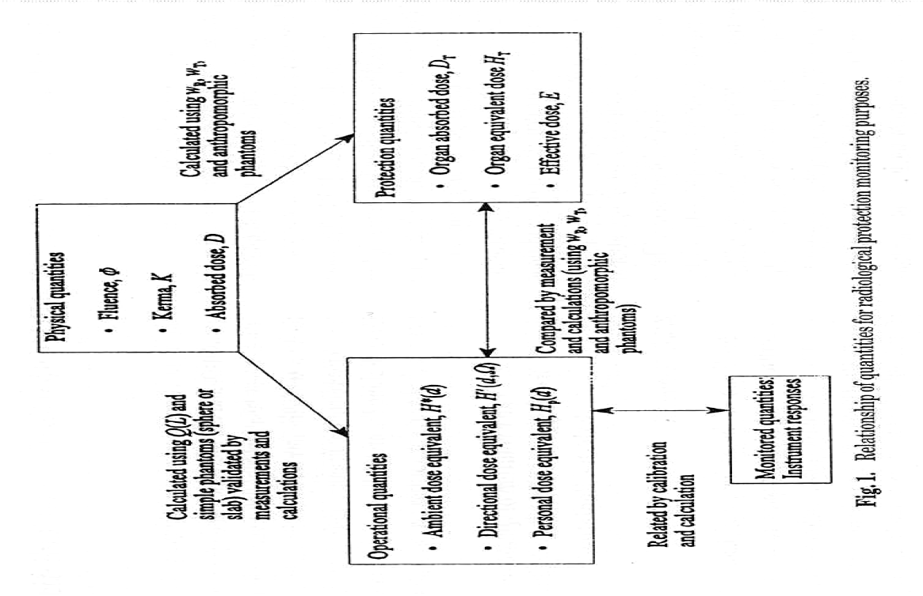
System of Quantities
Dosimetric quantities for external radiation (from ICRP 74 / ICRU 57)

