Slide 1
ERHS 630
The System of Radiation Protection
Alexander Brandl
Environmental and Radiological Health Sciences

Slide 2
Progression and Evolution
ICRP 26
dose limits
occupational exposure
prevention of non-stochastic effects
limitation of stochastic effects
ICRP 60
exposure (practice and intervention)
occupational, public, medical
proposed and continuing practices
justification, optimization, limitation
ICRP 103
process- to situation-based
planned, emergency, existing exposure situation

Slide 3
Consolidate and Develop
Individual dose limits
50 mSv a⁻¹ vs. 20 mSv a⁻¹
ICRP / IAEA and the U.S.
“as low as possible”
“as low as reasonably achievable, economic and social factors being taken into account” – (ALARA)
“as low as reasonably practicable” – (ALARP) ?
ALARA
has resulted in substantial decreases in individual doses
reduced situations where dose limits play major role in system of protection

Slide 4
Consolidate & Develop (II)
Why ICRP 103?
skepticism (international, stakeholder)
“improving protection?”
“new scientific basis?”
“change to dose limits?”
Features
updated w_{R} and w_{T}, radiation detriment
maintaining 3 Fundamental Principles
evolution from process- to situation-based approach
maintaining individual dose limits in planned exposures
re-enforcing the principle of optimization; dose and risk constraints (planned) and reference levels (emergency or existing)
including approach for developing framework for protection of the environment

Slide 5
Consolidate & Develop (III)
Scope of ICRP 103
system of radiological protection applies
to all exposures to ionizing radiation, regardless of size and origin
however, source of exposure or pathways leading to dose must be amenable to control
excluded, if deemed not amenable to control with regulatory instruments
exempted, where controls are regarded as unwarranted

Slide 6
System of Protection
Characterization of possible exposure situations
Classification of types of exposure
Identification of exposed individuals
Categorization of types of assessment
source-related
individual-related
Precise formulation of the Principles of Protection
Level of individual doses which require protective actions
Conditions for the safety of radiation sources, including security, requirements for emergency preparedness and response

Slide 7
Scientific Basis
Review of biological and epidemiological information on health risks
distribution of relative risks for different organs or tissues; most notably for breast cancer and hereditary effects
assuming LNT: combined detriment still ∼ 5 % Sv⁻¹
DDREF unchanged at 2
prenatal exposure
cancer risk similar to irradiation in early childhood
threshold for induction of malformations and severe mental retardation
retention of dose limits for effective and equivalent dose
further information and revision might be needed (i.e., eye)
data on possible non-cancer diseases insufficient

Slide 8
ICRP Conclusions
No fundamental changes to the system of radiation protection needed (ICRP 60)
Numerical recommendations (ICRP 60) mostly remain valid
ICRP 103 should not imply major changes to radiation protection regulations (if based on ICRP 60 and subsequent policy guidance documents)
LNT still basis for summation of doses from external exposure and intake of radionuclides
Doses are calculated using reference computational phantoms; effective dose calculated to Reference Person not an individual

Slide 9
Effective Dose
Effective dose
intended for use as protection quantity
prospective dose assessment for planning and optimization, demonstration of compliance with regulatory dose limits
not recommended for epidemiological evaluations, detailed specific retrospective investigations of individual exposure and risk
Collective effective dose
instrument for optimization, comparing radiological technologies and protection procedures
mainly in occupational settings
not intended as a tool for epidemiological risk assessment
inappropriate in risk projections (calculation of cancer deaths from trivial individual doses to be avoided)

Slide 10
Exposure Situations
Planned exposure situations
planned introduction and operation of sources
includes situations previously termed “practices”
Emergency exposure situations
unexpected situations requiring urgent attention
occurring during operation of a planned situation
malicious act
Existing exposure situations
already exist when a decision on control has to be taken
natural background radiation

Slide 11
Fundamental Principles
Justification
any decision that alters the radiation exposure situation should do more good than harm
Optimization of Protection
the likelihood of incurring exposure, the number of people exposed, and the magnitude of their individual doses should all be kept as low as reasonably achievable, taking into account economic and societal factors
Application of Dose Limits (planned exposures only!)
the total dose to any individual from regulated sources in planned exposure situations other than medical exposure should not exceed the appropriate limits

Slide 12
Fundamental Principles (II)
Categories of exposure
occupational
public
upon declaration of pregnancy: embryo / fetus
medical
patients
comforters, carers, volunteers in research

Slide 13
Justification
Any decision-making process should explicitly include expected changes in radiation detriment
Consequences considered not confined to radiation protection
need to include other risks, cost-benefit of the activity
Requirement that net benefit be positive!
planned exposures: only to be introduced if net benefit to the individual or society as a whole offsets radiation detriment
emergency or existing exposures: decisions taken to reduce doses should do more good than harm

Slide 14
Justification (II)
Some exposure scenarios deemed unjustified by ICRP
deliberate addition or activation of radionuclides in food, beverages, cosmetics, toys, personal jewelry and adornments
radiological examination for occupational, health insurance, or legal purposes undertaken without reference to clinical indications (exceptions: expected important information on the health of the individual, important criminal investigation)
medical screening of asymptotic population groups, unless advantages for the individual or society as a whole outweigh costs and detriment

Slide 15
Optimization
Only for justified exposure situations
Source-related process
Aimed at achieving best level of protection under the prevailing circumstances
Iterative process, involving:
evaluation of the exposure situation, including any potential exposures
selection of an appropriate value for constraints or reference levels
identification of potential protection options
selection of the best option (cost-benefit) under the prevailing circumstances
implementation of selected option

Slide 16
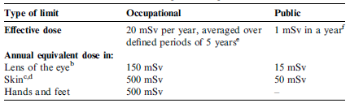
Limitation
ICRP dose limits
“not” changed from ICRP 60
(from ICRP 103)

Slide 17
Dose Constraints
Key role of optimization emphasized
Restrictions are applied to doses to a nominal individual (Reference Person)
dose constraints
planned exposure situations
reference levels
emergency and existing exposure situations
Options where E > constraint, should be rejected at planning stage
applied prospectively (optimization!)
After optimization is completed and E > constraint
reasons to be investigated
regulatory action not necessarily prompted

Slide 18
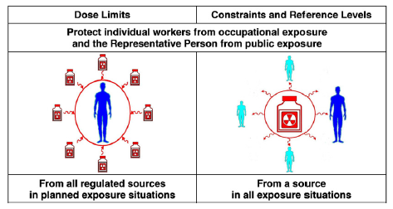
Limits and Constraints
Dose limits vs. dose constraints or reference levels
workers and members of the public
(from ICRP 103)

Slide 19
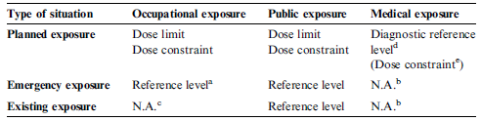
Limits and Constraints (II)
Dose limits, dose constraints, and reference levels
(from ICRP 103)

Slide 20
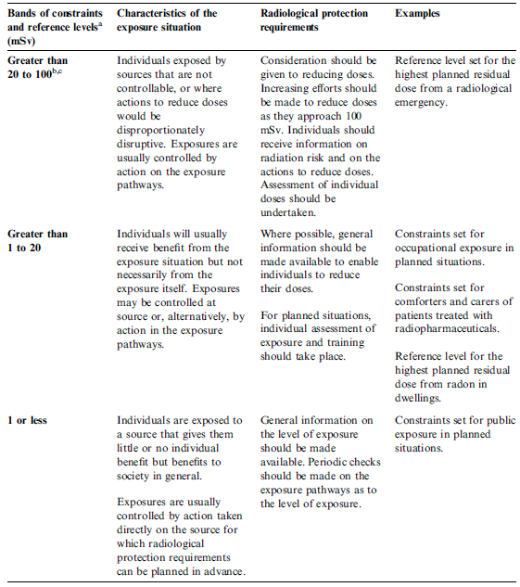
Limits and Constraints (III)
Dose constraints and reference levels
(from ICRP 103)

Slide 21
Planned Exposures
Previously managed as practices
includes: protection during medical uses of ionizing radiation
patients, comforters, carers, volunteers in biomedical research
Planning of planned exposure situations
to include deviations from normal operating procedures
potential exposures
accidents or malicious events
not planned, but can be anticipated
Designer and user of sources
reduction of likelihood for potential exposures
assessment of likelihood and installation of engineering safeguards

Slide 22
Emergency Exposures
Reference levels
residual dose after implementation of measures should be below reference levels
total dose regulator plans not to exceed in an emergency
for optimization use of averted dose
Emergency preparedness
planning for the implementation of optimized protection strategies
purpose: reducing exposures to below the reference level
Emergency response
reference level acts as benchmark for evaluating effectiveness of protective actions
input in establishing need for further actions

Slide 23
Existing Exposures
Exposure situations
naturally occurring exposures
past events
past accidents
Protection strategies
often implemented in an interactive, progressive manner
over many years

Slide 24
Existing Exposures (II)
Example
²²²Rn in dwellings and workplaces
recent epidemiological studies
confirm health risk from radon
provide support for recommendations on protection against radon
national reference levels
for the sake of continuity and practicability
E < 10 mSv a⁻¹ (600 Bq m⁻³) in dwellings
in workplaces: E > reference level
occupational exposure
optimization even if E < reference level

Slide 25
Environment
Radiation protection of the environment
previously
concern mainly for transfer of radionuclides through the environment
context of planned exposure situations
protection of the general public
would ensure that other species are not put at risk
scientifically sound framework for protection of the environment in all exposure situations
use of Reference Animals and Plants
doses calculated for reference organisms could be compared to doses known to have specific biological effects (at a given dose rate)
no dose limits

